Slide 1
Exam 2 Analytics Q2
Andrew Fish

Slide 2
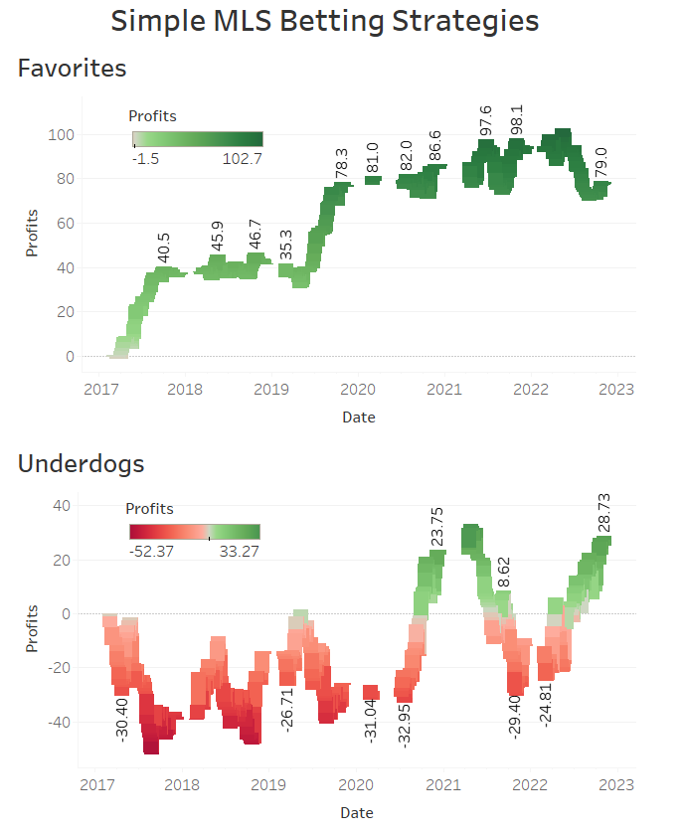
Favorites & Underdogs
Strategy | Returns | Profit | Profit%
Favorites | 2530.4 | 77.4 | 3.16%
Underdogs | 2481.73 | 28.73 | 1.17%
From the tables and the graphs, it can be seen that the strategy of only betting Favorites is more profitable than only betting Underdogs in MLS from 2017-2022
Surprising as Underdogs normally give larger payouts compared to Favorites
Favorites more sustainable bet as spending more time in the green (earning a profit) compared to the Underdogs
*Returns and Profits calculated using a $1 bet for every game

Slide 3
Home, Away & Draw
Strategy | Hit Rate
Home | 51.3%
Away | 25.71%
Draw | 22.99%
Home teams won at an alarming rate in MLS from 2017-2022
This could possibly be leveraged to be a sustainable profit earning wager
After examining the rates of Home, Away, and Draw, further investigation was performed on the returns and profits of betting on the Home team. Specifically, Home and Home Underdogs

Slide 4
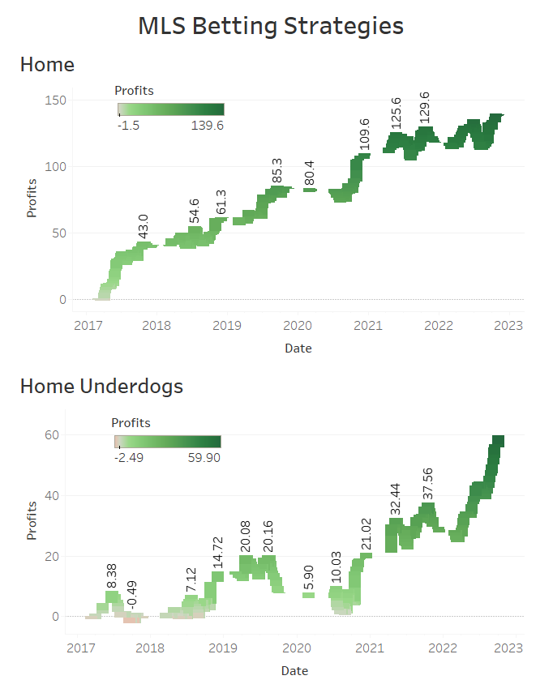
Home & Home Underdogs
Strategy | Returns | Profit | Profit%
Home | 2596.02 | 138.02 | 5.62%
Home Underdogs | 393.9 | 58.9 | 17.58%
Placing bets on Home or Home Underdogs is a more profitable strategy than betting Favorites or Underdogs
The most profitable strategy is leveraging the home-field-advantage in MLS and wagering on Home Underdogs, with 17.58% profit rates
Over the course of multiple seasons this strategy can be very lucrative using a larger bet size
*Returns and Profits calculated using a $1 bet for every game

